Slide 1
AccountaBuddy
By Elizabeth, Jake, Aadila
Notes:
Overall: need a market analysis slide

Slide 2
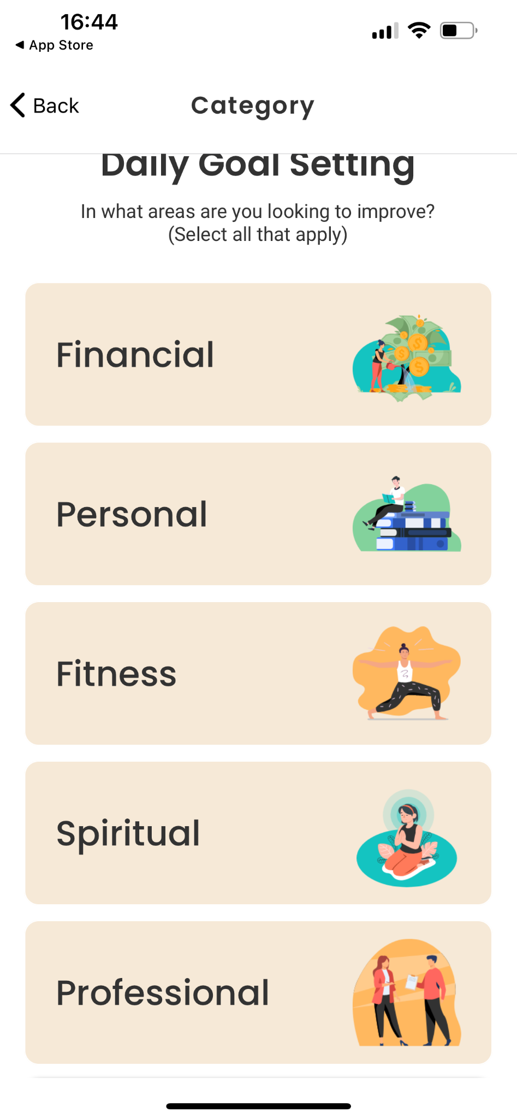
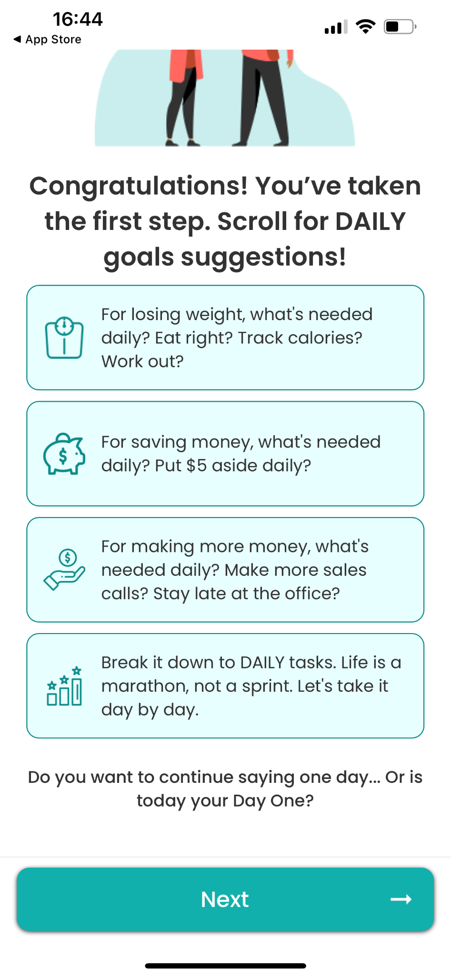
What is Accountabuddy?
Small but growing app-based accountability service
Assists people with staying on track with their personal and professional goals
Fitness
Work projects
Personal development
And many more
App matches users with accountability partners to keep them motivated
Offers monthly check
Goal-setting resources
Progress tracking through app

Slide 3
Issues with AccountaBuddy
Potential users have difficulty learning about service before downloading app
Minimal web presence makes it hard for potential users to discover the app
Without a well-organized, intuitive design, potential users may leave before downloading the app.
Current users lack central place to interact outside mobile platform
Lack of a web platform limits interaction and reduces long-term user retention
Website lacks functionality
Does not have a full-fledged website.
Users can’t engage or track progress outside of the mobile app.

Slide 4
Goal Tracking App Market
Self-help market is expected to grow from $38.3 billion to $40.6 billion
Clear opportunity to capture part of this expanding market
Positioning the app not only as a productivity tool but also as a self-help resource could help it appeal to a wider audience
Productivity and goal tracking market is currently highly competitive
Increase in demands for apps focusing on mental wellness, financial planning, and overall self improvement
With a focus on productivity, leveraging platforms like Instagram, Twitter, and TikTok could help the growth of this platform
Could also partner with social media Influencers to make their app soar
Notes:
Looking for:
Simple, easy-to-navigate goal-tracking tool
Customizable and motivating features
Quick access to progress charts and reminders
Interaction with market:
Set personal goals and track progress regularly
Receive reminders and notifications to stay on track
Use apps primarily, but web interfaces provide a more complete view

Slide 5
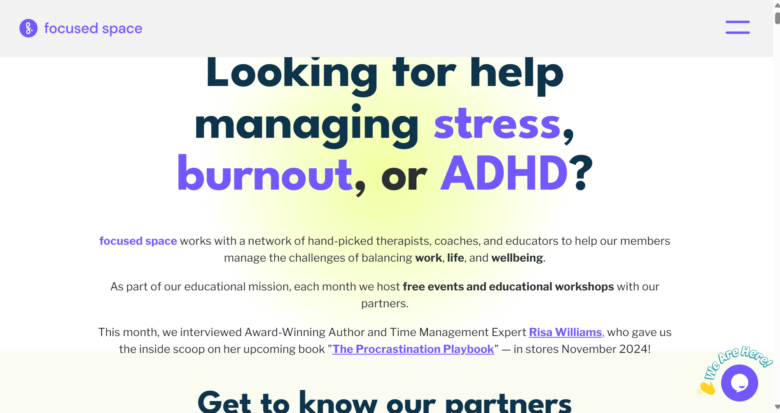
Notes:
Focused space partners with a network of therapists, life coaches, and educators to help their members manage any challenge that comes their way. It helps them balance work, life, and overall well being.
Focused space also host free events and educational workshops with their partners monthly
At the moment, there is a display of the apps features and UI to entice potential customers. There is also a larger and more descriptive blog section for reviews and recent customer support.

Slide 6
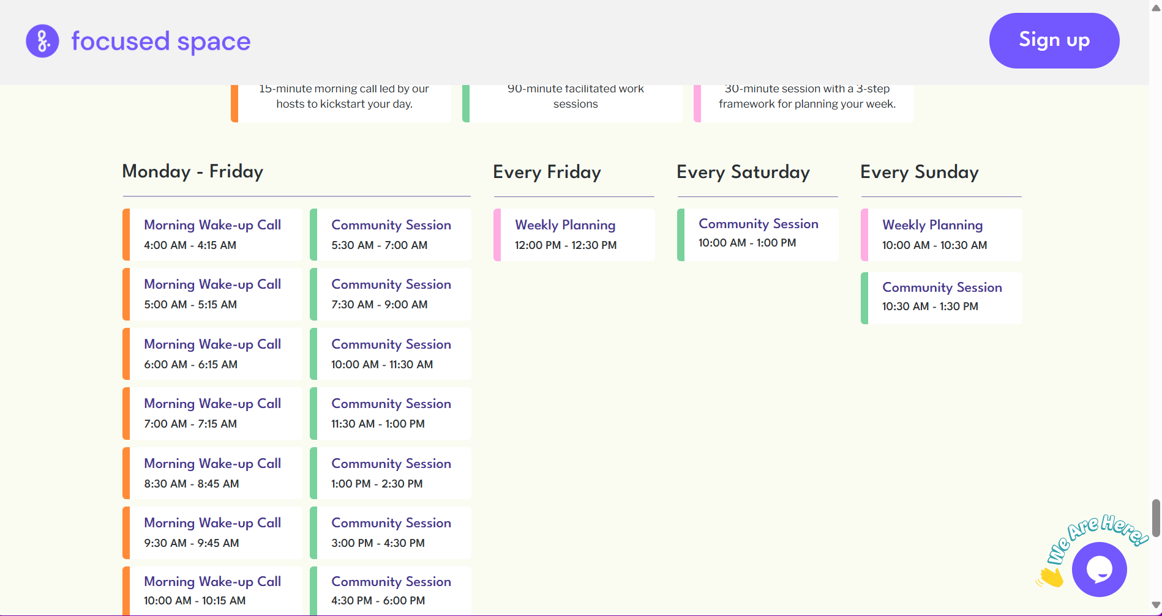
Notes:
Example of notifications from the app (keeps you on track with goals)

Slide 7
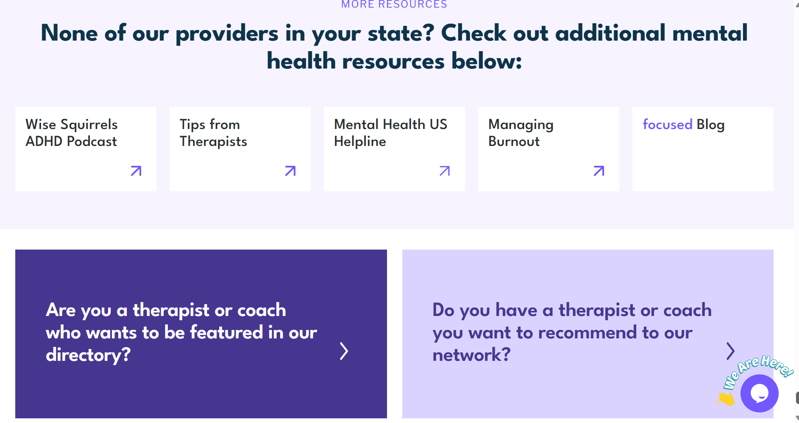
Notes:
Focused space has countless resources to help alongside their app.

Slide 8
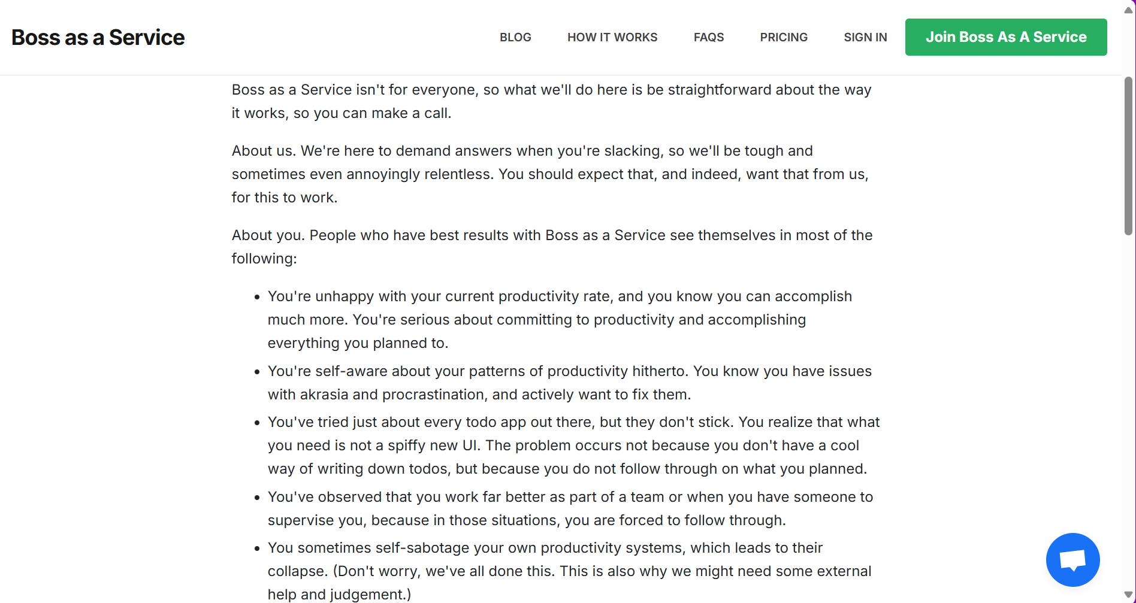
Notes:
Different tools to understand WHY you procrastinate
Promise will not stop contacting you until task is complete
In-depth description of how website works

Slide 9
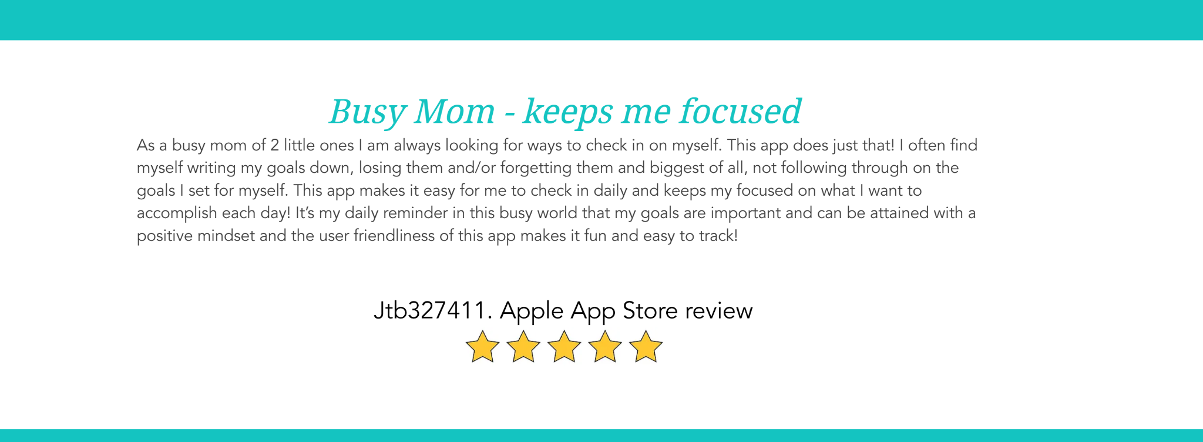
Proposed Improvements
To increase visual appeal and traffic flow to the site, We suggest improvements
•A longer and more in-depth view on a users experience
•An easier way to post reviews and even respond to others
•A improvement to how users interact with each other
•A simpler page layout for signup as well
Notes:
A common practice among several websites and apps that focus on this self help space. Usually have a very active and in depth user base
The site is missing the connectivity that other sites have and a site that more largely focuses on that user connection and community will increase traffic flow to the site and improve the user experience
So the recommend improvements is making a more diverse community review space. And a faster and quicker sign up process to allow users to start interacting immediately.

Slide 10
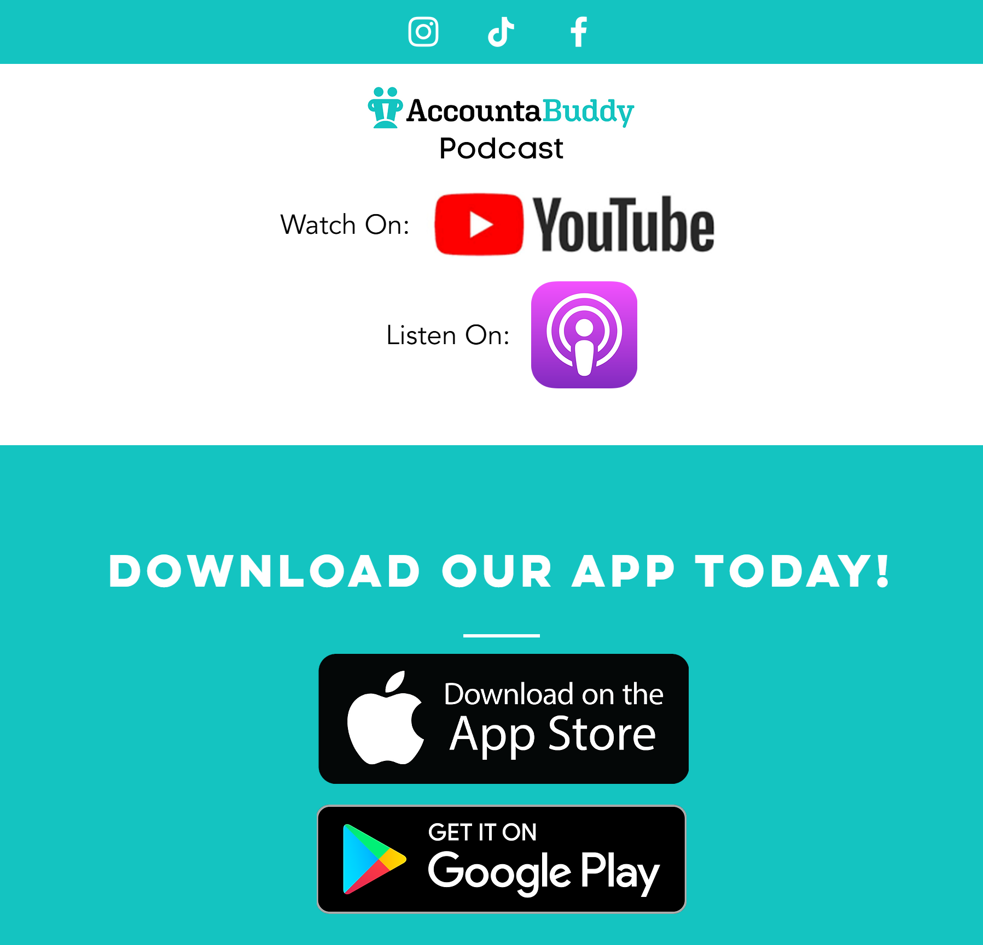
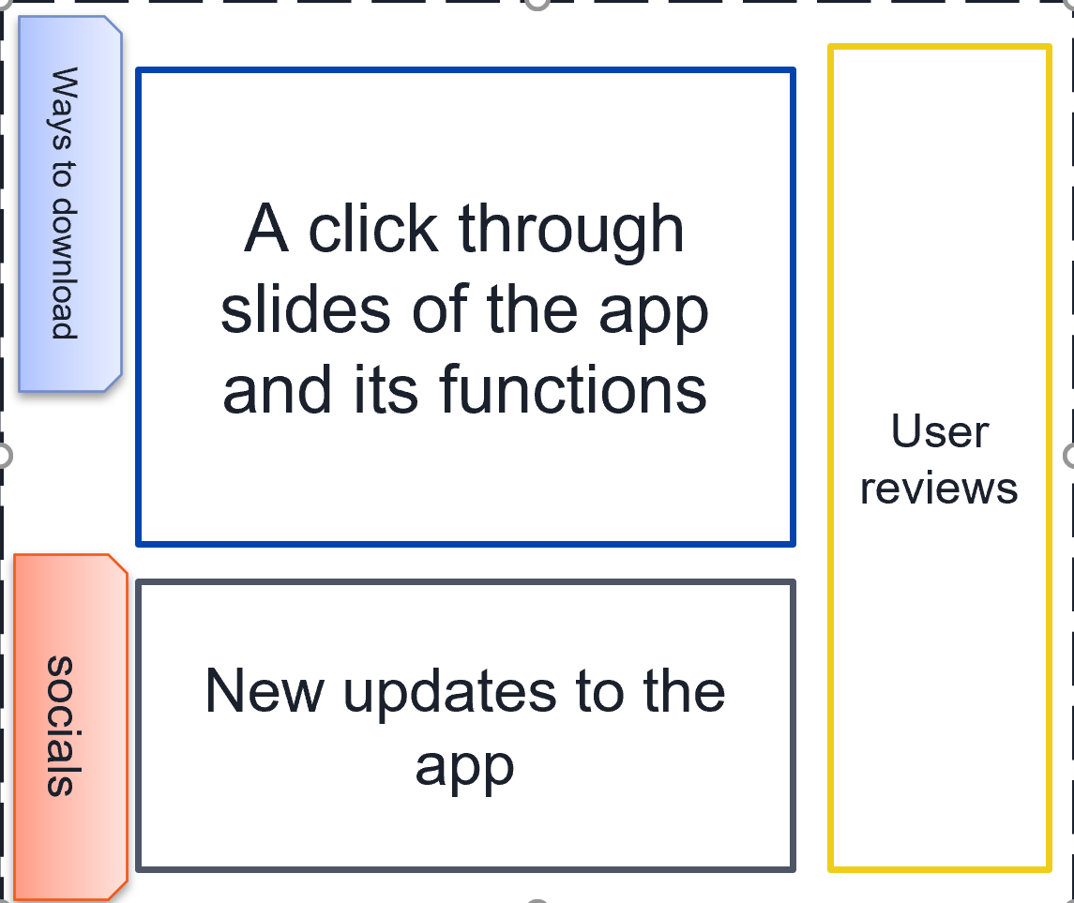
Proposed Improvements
A more user friendly site also improves a user experience
Notes:
Showcasing how the original site has a simple block design, making users scroll for more information that could be displayed on one page.
The new site wire frame shows how all the information taken from the entire site can be made into just one page.
And side bars that are constantly attached allowing users to also interact with the most important part of the site (downloads/ socials)
FOCUS ON IT AS A WEBSITE NOT AN APP

Slide 11
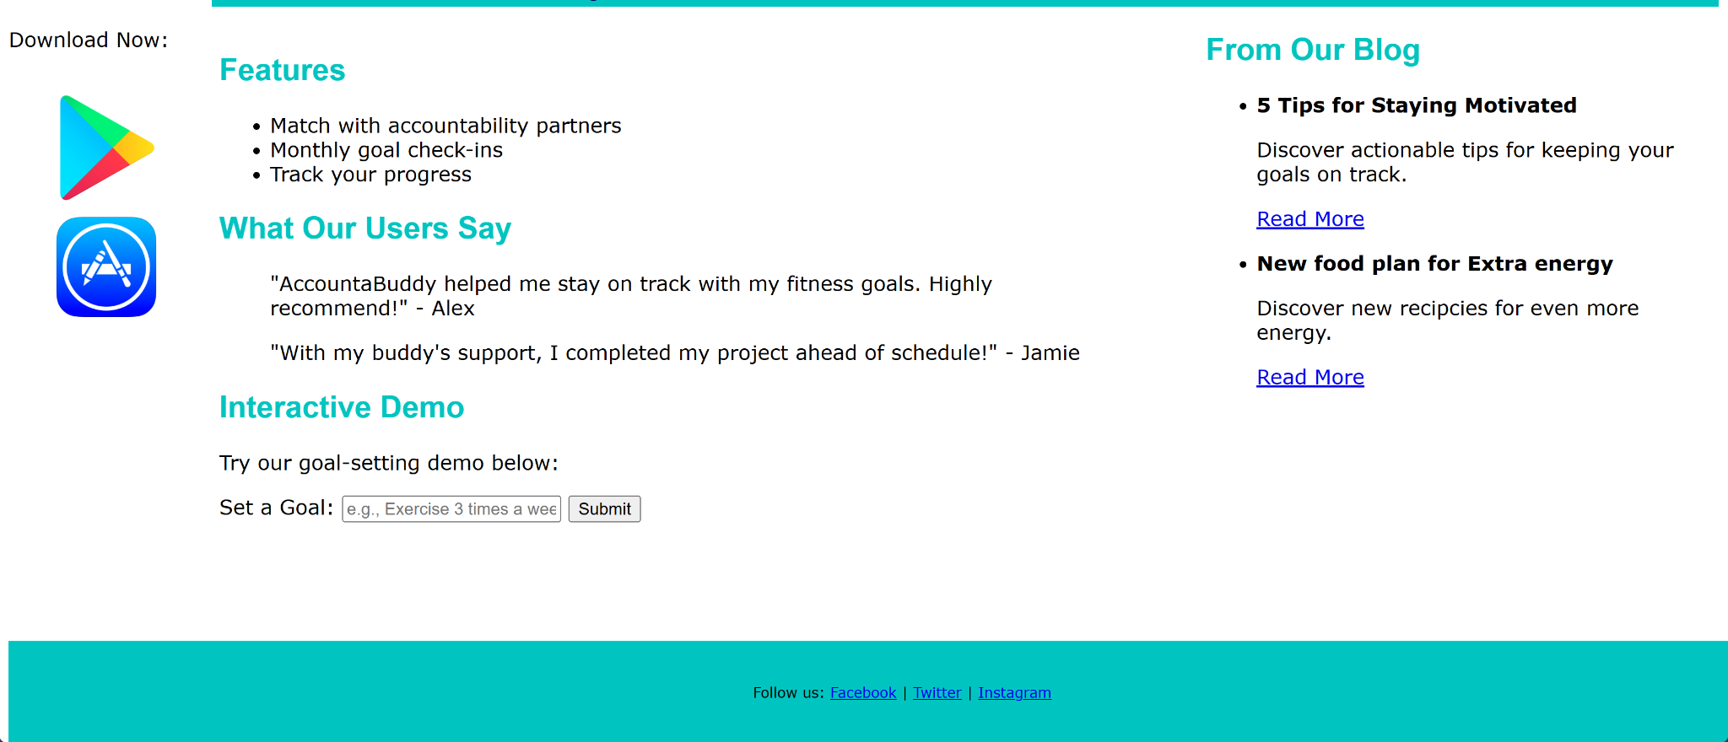
Functionality
The Main improvement is to condense the information to a single page at a time.

Slide 12
Implemented & Not implemented
A condensed contacts was added to always be easily accessible
The downloads are always available
A long navbar was left out of the wireframe version to allow a less cluttered page.
A large color palette was condensed to 3 colors

Slide 13
Resources / hardware used
We used Google’s web development tools, mobile viewing.
Web Development and Design Foundations with HTML5 textbook
Notepad++ for coding
The reference site of Accountabuddy

Slide 14
Task delegation
Creation and modification of slideshow - Elizabeth, Jake, Aadila
Initial code base and wireframe for website - Jake, Aadila
Research in the self help industry (Marketing & competitors) - Elizabeth, Aadila
Testing functionality of website structure -, Jake, Aadila

Slide 15
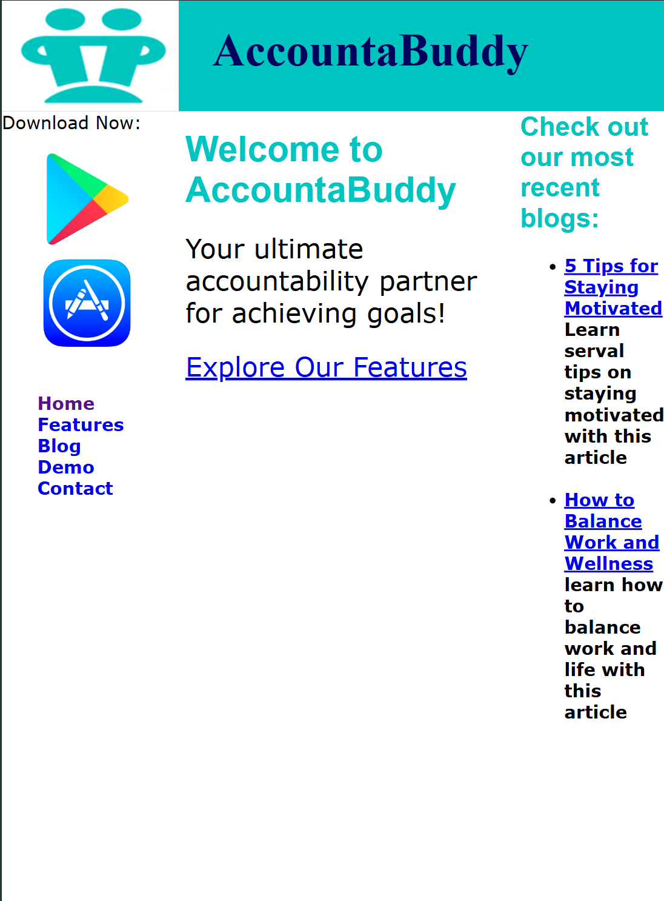
Testing strategy
A large range of different browsers were tested.
Chrome
Firefox
Bing
DuckDuckgo
The website was also tested to function on
mobile devices as well.

Slide 16
Lessons learned
Web development and implementation takes several different requirements to be fully functional.
Most Websites use javascript to allow a faster form of functionality. But standard Html5 can still be very useful

Slide 17
Sources / References
https://www.accountabuddy.com/
https://get.focused.space/
https://bossasaservice.com
Notes:
Include items from each website we liked/took inspiration from
Reference sites should be placed on separate slides explaining what features we desire to pull from those sites
Market research - what is the app market?
pull in stats from field the app is in
Introduce info about market
Market they haven’t touched (and size) and how to reach it

